Slide 1
Credit Card Predictive Analysis
-By
Devi Manaswi Kallam
rc75736

Slide 2
Contents
Overview
About Dataset
Data Cleaning
Feature Engineering
EDA
Data Modelling
Conclusion

Slide 3

Overview
Even though the cash has more value than anything in this world, people prefer credit cards for payments.
Most of the people use credit cards as it is safe and easy to carry around.
Some of them find it easy to track their spending and get better rewards without changing their spending limits.
And there is also a major reason that anyone can build their credit histories.
So, with good credit history a person can get another card or housing, educational loans, insurance approved.

Slide 4
About Dataset
There are two datasets, one is application record (54.34MB) consisting of 438557 observations and 18 variables and the other one which is credit record(15.37MB) and it has 1048575 rows and 3 columns.
Application record consists of client’s personal and bank information.
Credit record consists of client’s credit card usage information.

Slide 5
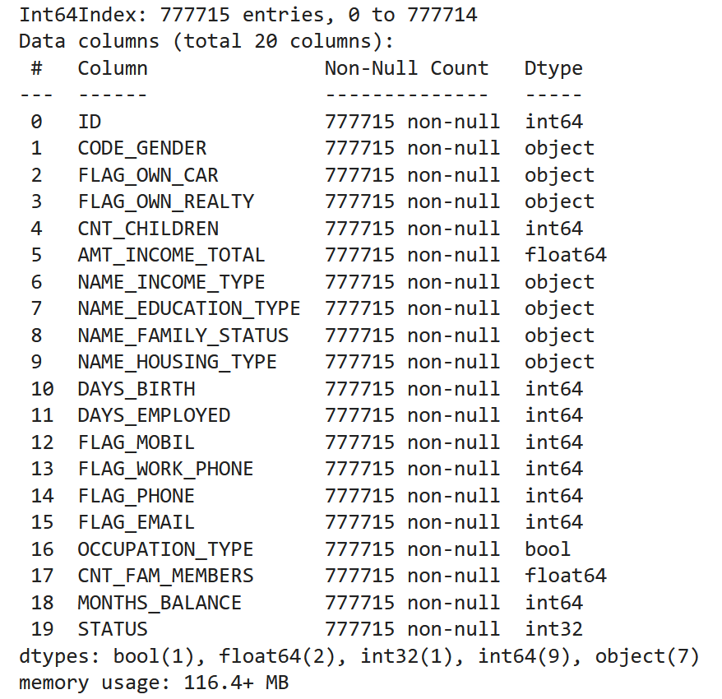
Attributes
ID
CODE_GENDER
FLAG_OWN_CAR
FLAG_OWN_REALTY
CNT_CHILDREN
AMT_INCOME_TOTAL
NAME_INCOME_TYPE
NAME_EDUCATION_TYPE
NAME_FAMILY_STATUS
NAME_HOUSING_TYPE
DAYS_BIRTH
DAYS_EMPLOYED
FLAG_MOBIL
FLAG_WORK_PHONE
FLAG_PHONE
FLAG_EMAIL
OCCUPATION_TYPE
CNT_FAM_MEMBERS
MONTHS_BALANCE
STATUS

Slide 6
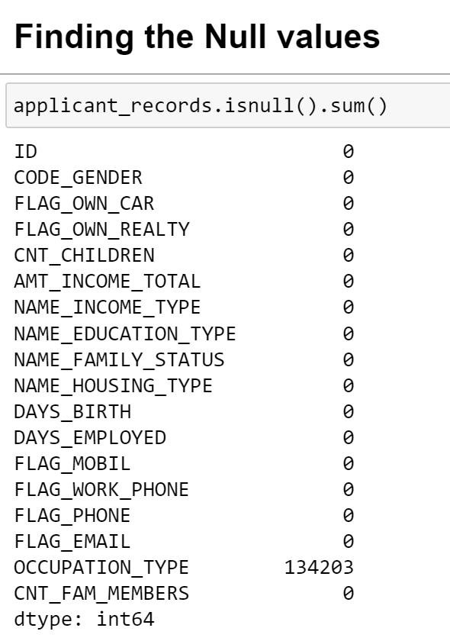
Data Cleaning

Slide 7
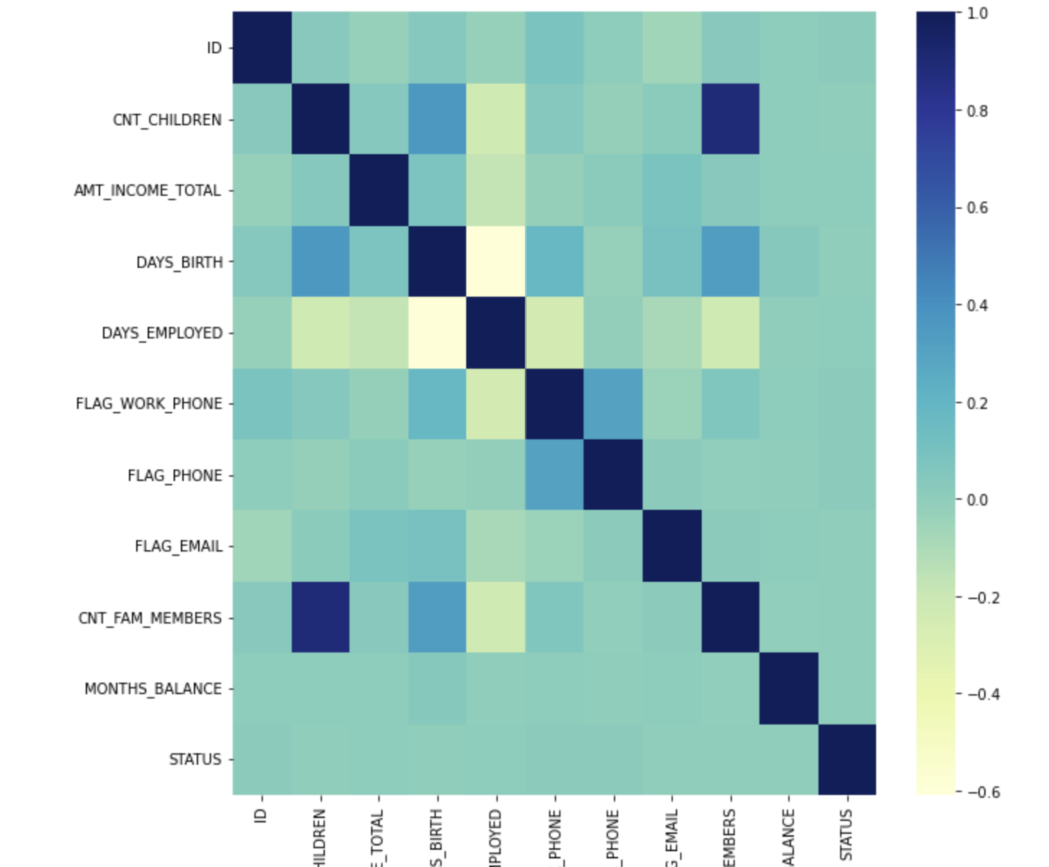
Correlation Matrix

Slide 8

Exploratory Data Analysis

Slide 9
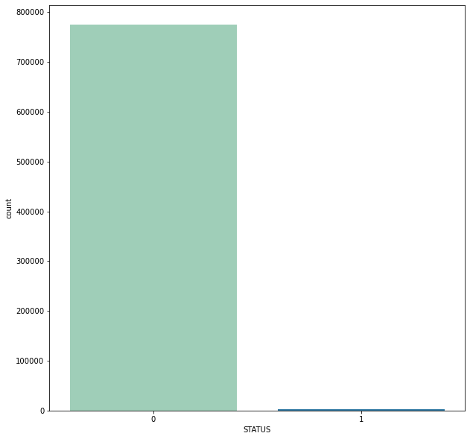
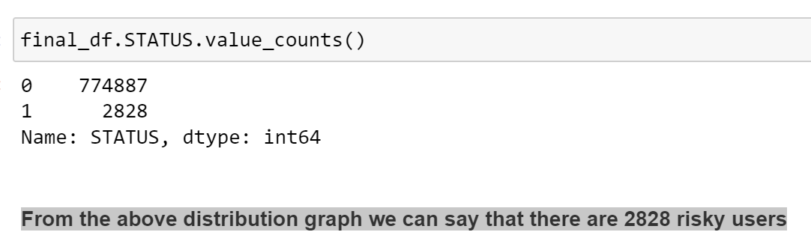
Target variable
774887 Good Customers
2828 Bad Customers

Slide 10
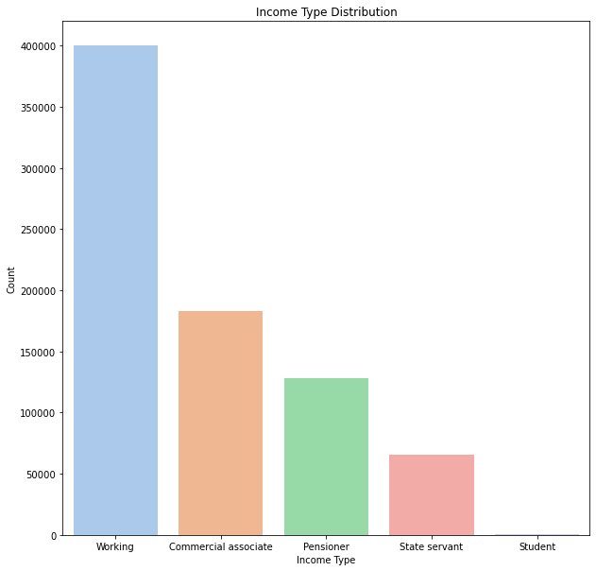

Slide 11
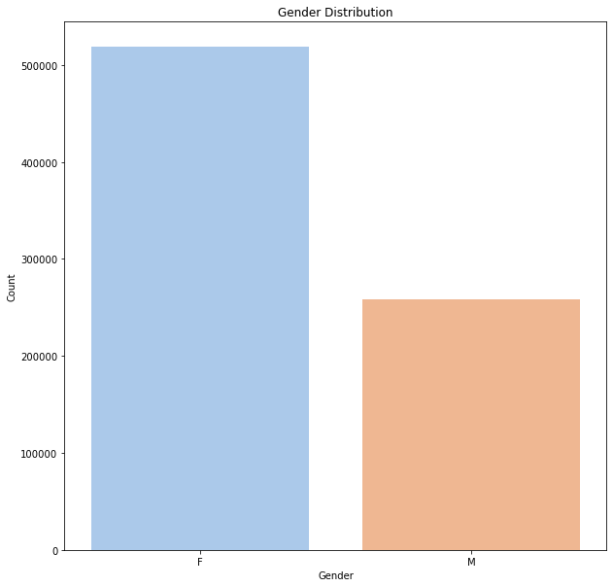
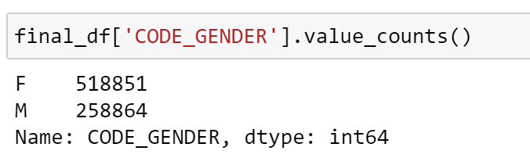

Slide 12
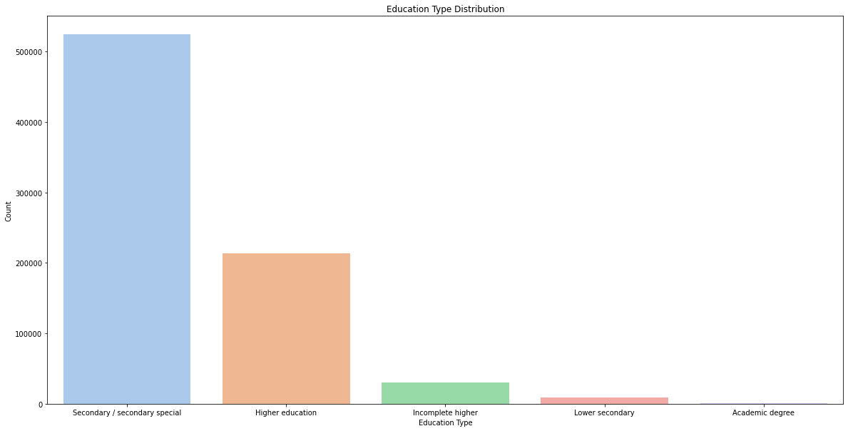

Slide 13
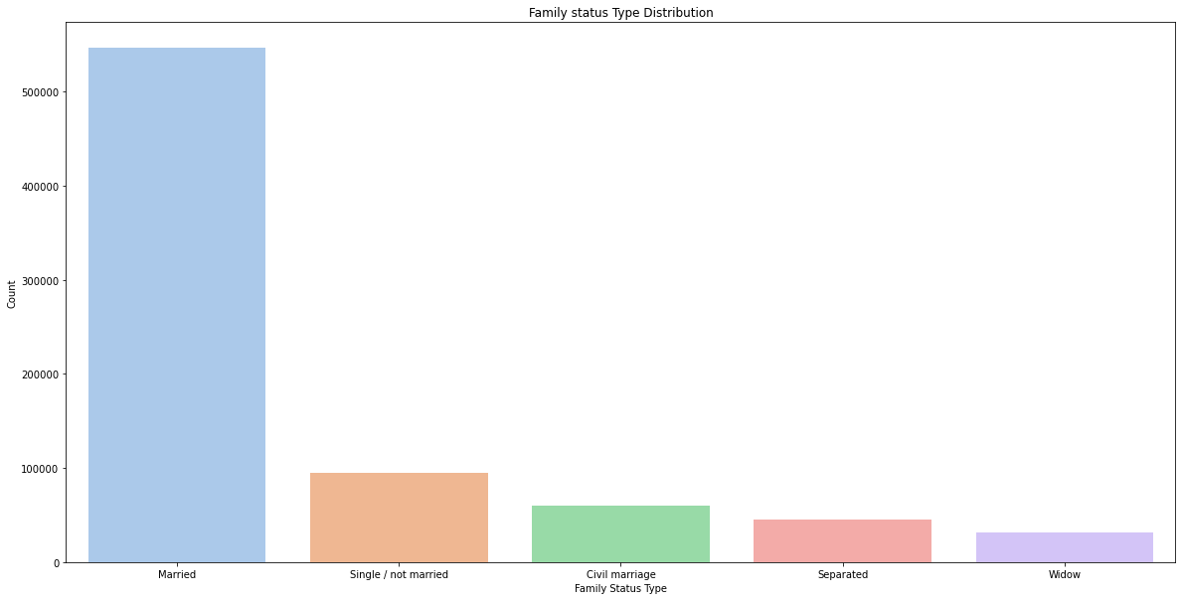

Slide 14
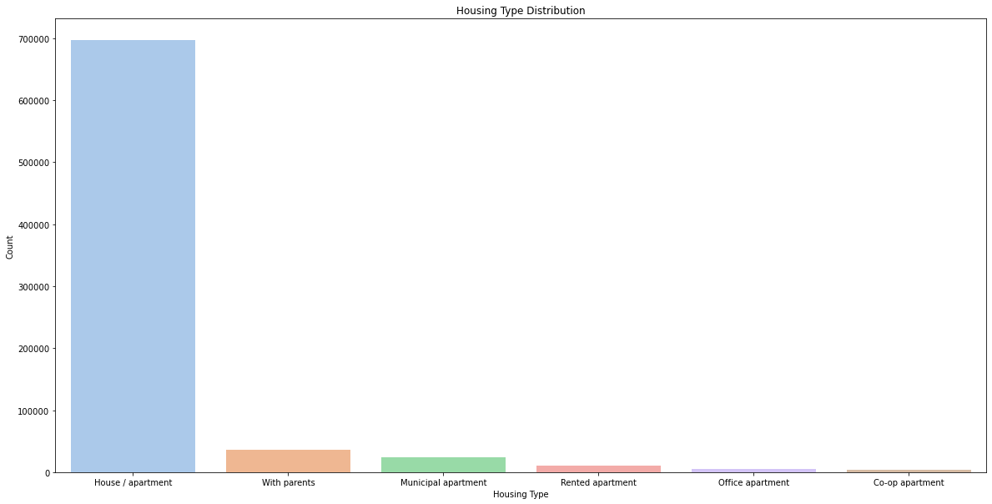

Slide 15
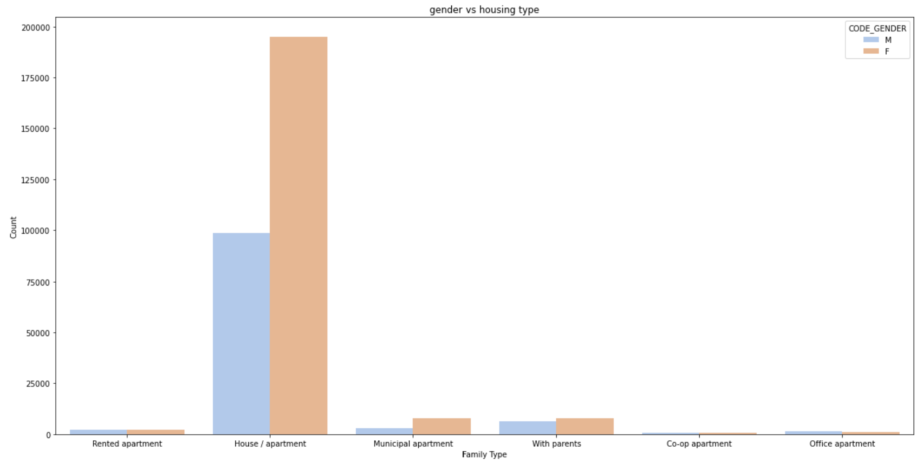

Slide 16
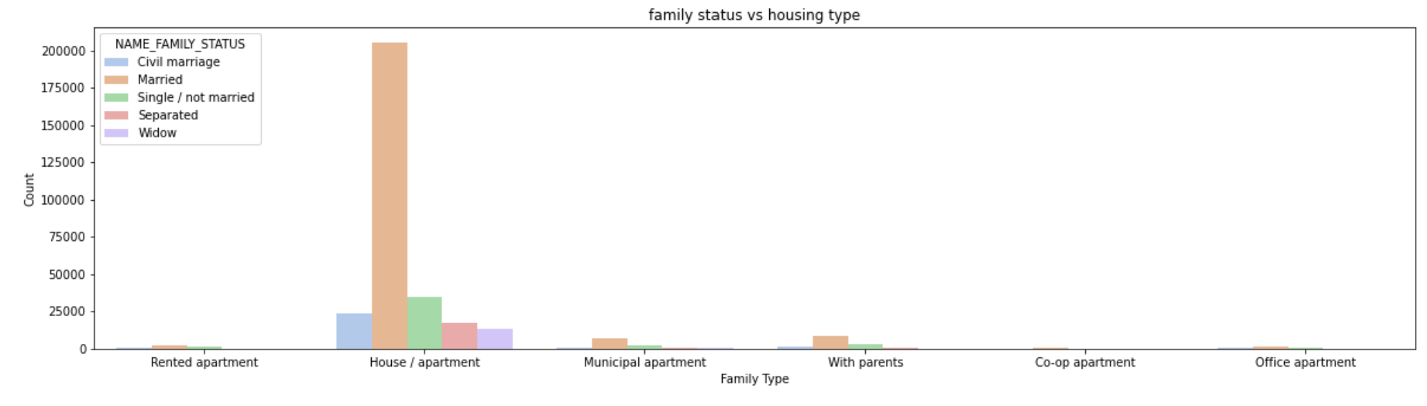

Slide 17

Feature Engineering
DAYS_BIRTH and DAYS_EMPLOYED are having negative values.
Converted two columns into date using function.
Calculated and replaced values with Age and number of employed days.
Replaced categorical values with numerical values

Slide 18
Data Modelling
Model | Accuracy
Logistic Regression | 57%
Xgboost | 87%
Random forest | 94%
Decision Tree | 78%
KNN Classification | 69%
SVC Classifier | 73%
Naive Bayes | 69%

Slide 19
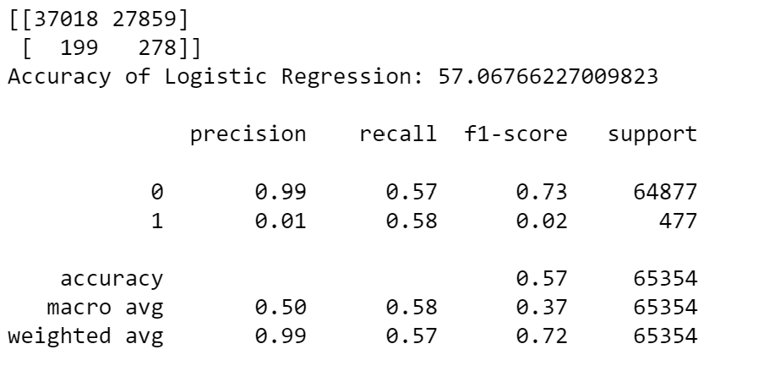
Logistic Regression

Slide 20
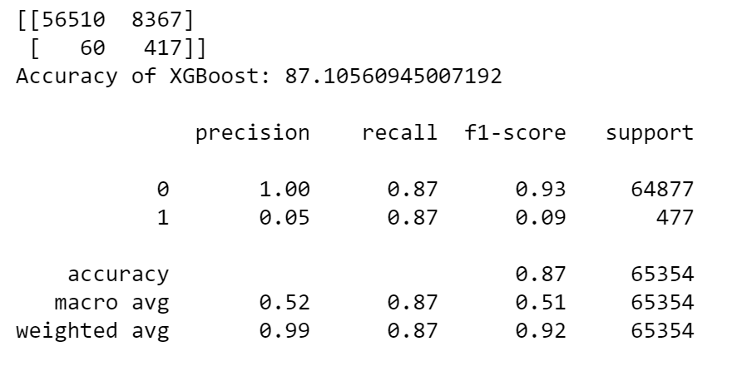
XgBoost

Slide 21
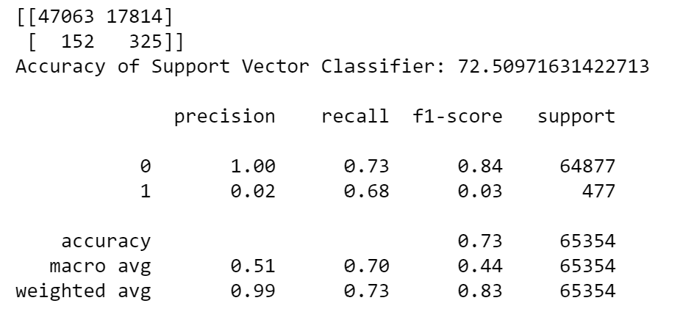
SVC Classification

Slide 22
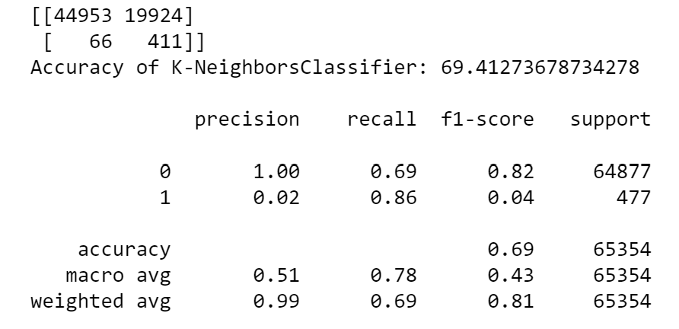
KNN Classification

Slide 23
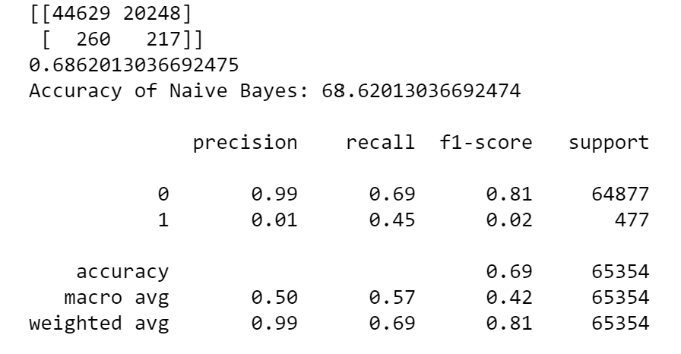
Naïve Bayes

Slide 24
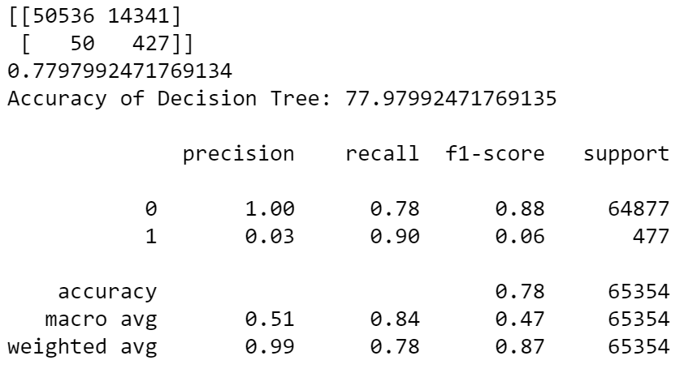
Decision Tree

Slide 25
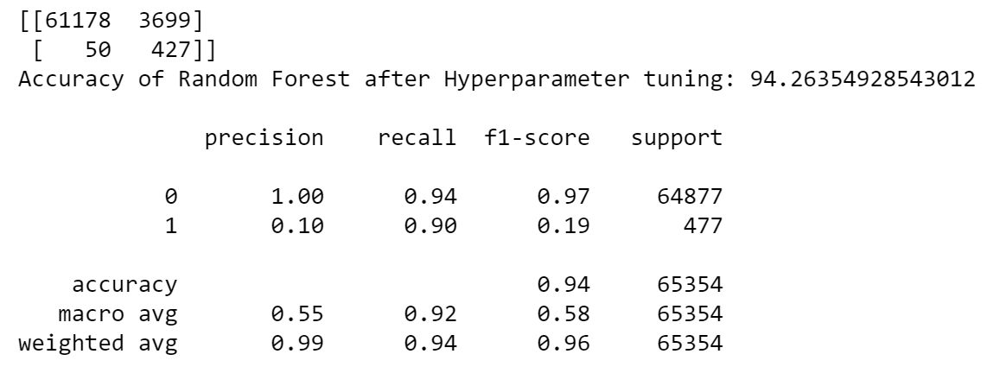
Hypertuning

Slide 26
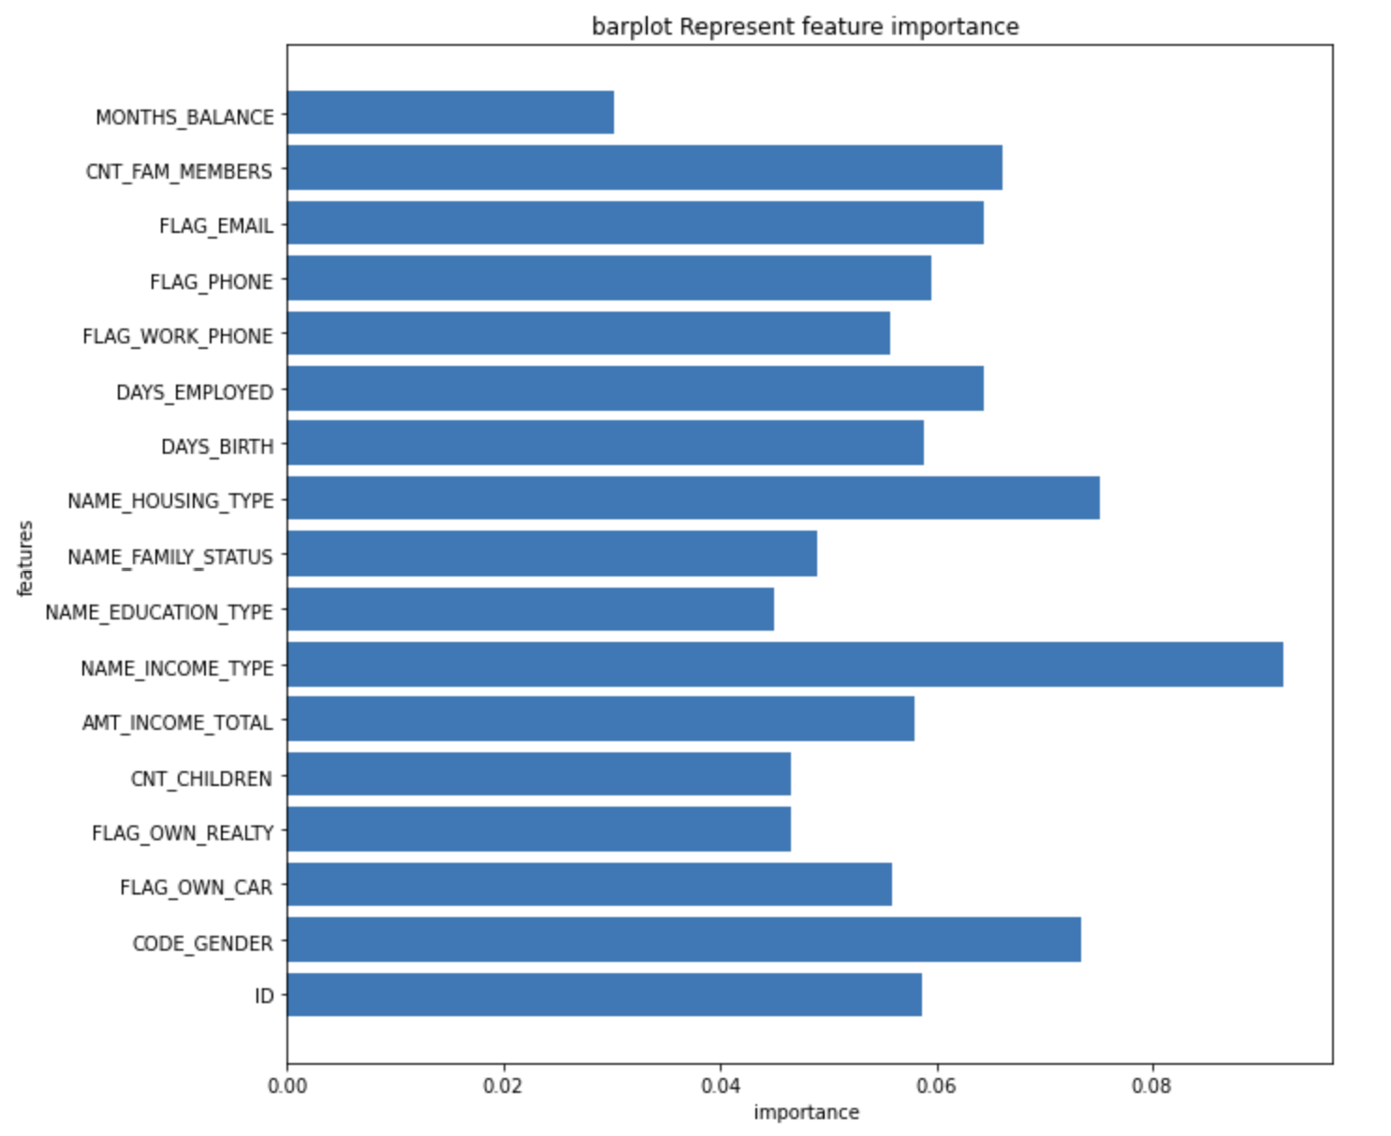
Feature Importance

Slide 27
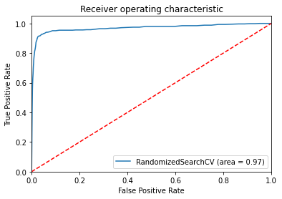
ROC CURVE

Slide 28
Challenges
Understanding the data
Selection of risk factors
Modelling, finding the best model to improve the accuracy of the prediction.

Slide 29
Conclusion
Random Forest gives the best accuracy compares to rest of the model.
Logistic regression gives the lowest accuracy
Income type factor is affecting the Target variable

Slide 30
Thank you

